Slide 1

EECS 482
Lab 4: Implementing Threads

Slide 2
Administrivia
Project 2
Due 02/15
Today: 02/03

Slide 3
Agenda
Implementing threads
Project 2
Smart Pointers
Goal: get you prepared for P2

Slide 4
Two perspectives on threads
User Perspective:
Threads run in parallel.
Thread states:
runnable, blocked
Kernel Perspective:
CPUs are finite.
Need to interleave threads.
Thread states:
running, ready, blocked

Slide 5
The goal of project 2 is to implement the thread library you used in project 1.
You are going to be implementing
threads
mutexes
cvs
Remember that a thread is just a stack, stack pointer, program counter, and a set of registers.
Linux provides ucontext as an encapsulation of this state as well as the functionality to make/swap/get/set ucontexts.

Slide 6
What information do we need to run a thread?
ucontext_t
Reg
PC
SP
Reg
Stack*
Reg

Slide 7
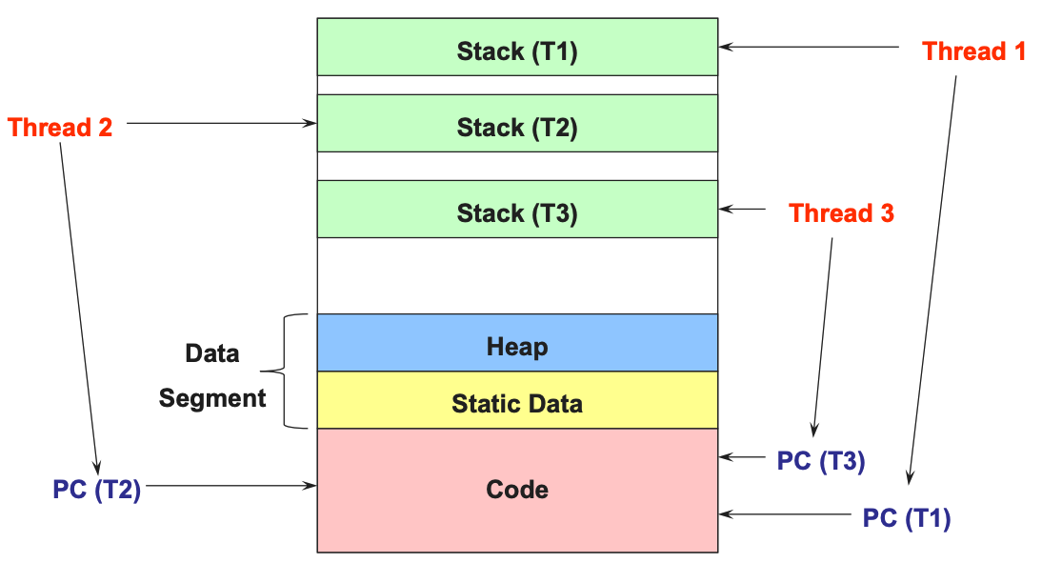

Slide 8
Consider two threads on a single-CPU machine...
int global = 0;
void bar(int n) {
global += n
printf("%i\n", n);
}
void foo() {
for (i = 0 -> 20) {
bar(i);
}
}
void bar(int n) {
global += n
printf("%i\n", n);
}
void foo() {
for (i = 0 -> 20) {
bar(i);
}
}

Slide 9
Consider two threads on a single-CPU machine...
int global = 0;
void bar(int n) {
global += n
printf("%i\n", n);
}
void foo() {
for (i = 0 -> 20) {
bar(i);
}
}
void bar(int n) {
global += n
printf("%i\n", n);
}
void foo() {
for (i = 0 -> 20) {
bar(i);
}
}
Stack A
Stack B
printf()
bar() [n]
foo() [i]
foo() [i]
Notes:
Remember that threads share the heap and global variables, but they each have their own stack.
Each thread needs its own stack because the CPU uses the stack to store local variables and remember how to return from function calls.

Slide 10
We run one thread for a while...
int global = 0;
void bar(int n) {
global += n
printf("%i\n", n);
}
void foo[threadA]() {
for (i = 0 -> 20) {
bar(i);
}
}
Stack A
foo() [i = 0]

Slide 11
We run one thread for a while...
int global = 0;
void bar(int n) {
global += n
printf("%i\n", n);
}
void foo[threadA]() {
for (i = 0 -> 20) {
bar(i);
}
}
Stack A
foo() [i = 0]

Slide 12
We run one thread for a while...
int global = 0;
void bar(int n) {
global += n
printf("%i\n", n);
}
void foo[threadA]() {
for (i = 0 -> 20) {
bar(i);
}
}
Stack A
bar() [n = 0]
foo() [i = 0]

Slide 13
We run one thread for a while...
int global = 0;
void bar(int n) {
global += n
printf("%i\n", n);
}
void foo[threadA]() {
for (i = 0 -> 20) {
bar(i);
}
}
Stack A
printf()
bar() [n = 0]
foo() [i = 0]

Slide 14
We run one thread for a while...
int global = 0;
void bar(int n) {
global += n
printf("%i\n", n);
}
void foo[threadA]() {
for (i = 0 -> 20) {
bar(i);
}
}
Stack A
bar() [n = 0]
foo() [i = 0]

Slide 15
We run one thread for a while...
int global = 0;
void bar(int n) {
global += n
printf("%i\n", n);
}
void foo[threadA]() {
for (i = 0 -> 20) {
bar(i);
}
}
Stack A
foo() [i = 0]

Slide 16
We run one thread for a while...
int global = 0;
void bar(int n) {
global += n
printf("%i\n", n);
}
void foo[threadA]() {
for (i = 0 -> 20) {
bar(i);
}
}
Stack A
foo() [i = 1]

Slide 17
We run one thread for a while...
int global = 0;
void bar(int n) {
global += n
printf("%i\n", n);
}
void foo[threadA]() {
for (i = 0 -> 20) {
bar(i);
}
}
Stack A
foo() [i = 1]

Slide 18
We run one thread for a while...
int global = 0;
void bar(int n) {
global += n
printf("%i\n", n);
}
void foo[threadA]() {
for (i = 0 -> 20) {
bar(i);
}
}
Stack A
bar() [n = 1]
foo() [i = 1]

Slide 19
We run one thread for a while…
Switch!!
int global = 0;
void bar(int n) {
global += n
printf("%i\n", n);
}
void foo[threadA]() {
for (i = 0 -> 20) {
bar(i);
}
}
Stack A
bar() [n = 1]
foo() [i = 1]
Notes:
And now let's say at this point the kernel decides to switch threads.
If we're going to be able to resume thread A, we're going to need a way to remember where we left off.
We need a snapshot of the current execution context.

Slide 20
An execution context describes what a CPU is doing.
int global = 0;
void bar(int n) {
global += n
printf("%i\n", n);
}
void foo[threadA]() {
for (i = 0 -> 20) {
bar(i);
}
}
CPU
Stack A
PC
A
10
PC
17
B
20
C
0
SP
SP
D
0
100
bar() [n = 1]
foo() [i = 1]
Notes:
Whenever code is running, there is a context.
To resume a thread at a later point in time, we need to save a snapshot of its execution context before switching threads. This snapshot is stored in a Thread Control Buffer (TCB).

Slide 21
The TCB stores a snapshot of a thread's context.
TCB A
CPU
10
PC
A
10
save_tcb()
20
17
B
20
0
C
0
SP
0
D
0
100
17
100

Slide 22
Contexts can be re-entered by loading a TCB.
TCB B
TCB A
CPU
0
10
PC
A
0
load_tcb()
0
20
10
12
17
B
0
0
0
20
C
0
0
0
0
SP
D
0
208
12
17
0
100
208
100

Slide 23
TCBs and contexts in Project 2
ucontext_t represents a thread's state (kind of like TCB)
getcontext(uc_current)
Saves the currently running context into uc_current
(not particularly useful - see hint in spec 3.2)
setcontext(uc_next)
Starts to run/resumes running uc_next
(doesn't save the currently running context)
Notes:
getcontext hint: think about what happens to the program counter of the current thread after it calls getcontext
setcontext: only useful if we don't care about storing the currently running context

Slide 24
TCBs and contexts in Project 2
swapcontext(uc_current, uc_next)
Effectively getcontext(current) and setcontext(next).
makecontext(uc, func, nargs, args...)
Sets up uc such that when you swap to it, it will begin executing code at the beginning of func, calling it with args.

Slide 25
Exercise: is this a correct implementation of swapcontext?
void swapcontext(ucontext_t *current, ucontext_t *next) {
getcontext(current);
setcontext(next);
}
Notes:
No, it is not. When we swap back, it will end up right after the call to getcontext(), so it will call setcontext again.

Slide 26
What does this program output?
ucontext_t ctxA, ctxB, ctxMain;
void funcA(int arg):
cout << arg << endl;
swapcontext(&ctxA, &ctxB);
void funcB(double arg):
cout << arg << endl;
swapcontext(&ctxB, &ctxMain);
void main():
makecontext(&ctxA, funcA, 1, 482);
makecontext(&ctxB, funcB, 1, 3.14);
swapcontext(&ctxMain, &ctxA);
cout << "done" << endl;

Slide 27
What does this program output?
ucontext_t ctxA, ctxB, ctxMain;
void funcA(int arg):
cout << arg << endl;
swapcontext(&ctxA, &ctxB);
void funcB(double arg):
cout << arg << endl;
swapcontext(&ctxB, &ctxMain);
void main():
makecontext(&ctxA, funcA, 1, 482);
makecontext(&ctxB, funcB, 1, 3.14);
swapcontext(&ctxMain, &ctxA);
cout << "done" << endl;
Output:
482
3.14
done

Slide 28
What does this program output?
ucontext_t ctxA, ctxB, ctxMain;
void funcA(int arg):
cout << arg << endl;
swapcontext(&ctxA, &ctxB);
void funcB(double arg):
cout << arg << endl;
swapcontext(&ctxB, &ctxMain);
void main():
makecontext(&ctxA, funcA, 1, 482);
makecontext(&ctxB, funcB, 1, 3.14);
swapcontext(&ctxMain, &ctxB);
cout << "done" << endl;
Output:
3.14
done

Slide 29
What does this program output?
ucontext_t ctxA, ctxB, ctxMain;
void funcA(int arg):
cout << arg << endl;
swapcontext(&ctxA, &ctxB);
void funcB(double arg):
cout << arg << endl;
swapcontext(&ctxB, &ctxMain);
void main():
makecontext(&ctxA, funcA, 1, 482);
makecontext(&ctxB, funcB, 1, 3.14);
swapcontext(&ctxB, &ctxA);
cout << "done" << endl;
Output:
482
done
Notes:
This slide was skipped during in person labs in an attempt to conserve time, but it still a good exercise to work through!

Slide 30
What does this program output?
ucontext_t ctxA, ctxB, ctxMain;
void funcA(int arg):
cout << arg << endl;
swapcontext(&ctxMain, &ctxB);
void funcB(double arg):
cout << arg << endl;
swapcontext(&ctxB, &ctxMain);
void main():
makecontext(&ctxA, funcA, 1, 482);
makecontext(&ctxB, funcB, 1, 3.14);
swapcontext(&ctxMain, &ctxA);
cout << "done" << endl;
Output:
482
3.14

Slide 31
Interrupts

Slide 32
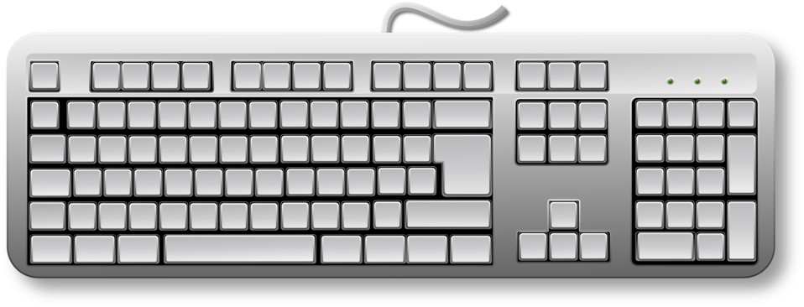
Interrupts are hardware events, handled by the OS.
Operating System
handle_key()
Pass keyboard event to the active window
CPU
KEY

Slide 33

Interrupts are hardware events, handled by the OS.
Operating System
handle_timer()
Switch to next ready thread
CPU
TIMER

Slide 34
The CPU checks the interrupt vector table and calls handler.
EXC
&handle_exception
KEY
&handle_key
Operating System
Functions:
handle_exception()
handle_ipi()
handle_key()
handle_timer()
handle_trap()
IPI
&handle_ipi
TIMER
&handle_timer
TRAP
&handle_trap
CPU
Notes:
Remember that interrupts are hardware events, so when they occur, the CPU checks a portion of memory called the interrupt vector table to find out which OS handler function to call.

Slide 35
Interrupts are like forced function calls.
Kernel level
interrupt handler function
interrupt occurs, call interrupt handler
interrupt handler returns to user code
User level

Slide 36
Interrupts in Project 2
Timer interrupts: generated by the infrastructure.
Inter-processor interrupts: triggered by OS programmer (you)
some_cpu_ptr->interrupt_send()
class cpu {
// ...
static const unsigned int TIMER = 0;
static const unsigned int IPI = 1;
interrupt_handler_t interrupt_vector_table[IPI+1];
// ...
}
Notes:
The timer interrupts are generated by the infrastructure, but it is your job to switch contexts when a timer interrupt occurs. It will not happen automatically by the infrastructure.
You'll accomplish this by implementing interrupt handler functions.

Slide 37
Declare and define interrupt handler functions.
void timer_handler() {
cpu::interrupt_disable();
printf("Timer interrupt occurred!\n");
cpu::interrupt_enable();
}
void ipi_handler() {
cpu::interrupt_disable();
printf("Cpu %x waking up\n", cpu::self());
cpu::interrupt_enable();
}

Slide 38
Populate interrupt vector table in cpu::init
void timer_handler() {...}
void ipi_handler() {...}
void cpu::init(...) {
interrupt_vector_table[TIMER] = timer_handler;
interrupt_vector_table[IPI] = ipi_handler;
// ...
}

Slide 39
Timer interrupts trigger context switches.
Thread A
i = 0
bar(i)
i = 1
bar(i)
i = 2
Thread B
i = 0
bar(i)
i = 1
...
TIMER!
TIMER!
TIMER!

Slide 40
Interrupts may break kernel critical sections.
void mutex::lock() {
if (status == FREE) {
status = BUSY;
}
else {
waiting.push(curThread);
switch(curThread, nextThread);
}
}

Slide 41
Interrupts may break kernel critical sections.
void mutex::lock() {
if (status == FREE) {
status = BUSY;
}
else {
waiting.push(curThread);
switch(curThread, nextThread);
}
}
TIMER!
Notes:
What could go wrong here?

Slide 42
Disable interrupts during kernel critical sections.
void mutex::lock() {
interrupt_disable();
if (status == FREE) {
status = BUSY;
}
else {
waiting.push(curThread);
switch(curThread, nextThread);
}
}

Slide 43

Re-enable interrupts before returning to user code.
void mutex::lock() {
interrupt_disable();
if (status == FREE) {
status = BUSY;
}
else {
waiting.push(curThread);
switch(curThread, nextThread);
}
interrupt_enable();
}
Why?

Slide 44
The switch invariant
A context switch is not an atomic operation.
An interrupt during swapcontext() could be catastrophic.
We enact the following invariant:
All threads must have interrupts disabled during a context switch.
All threads assume that interrupts are disabled upon returning from swapcontext

Slide 45
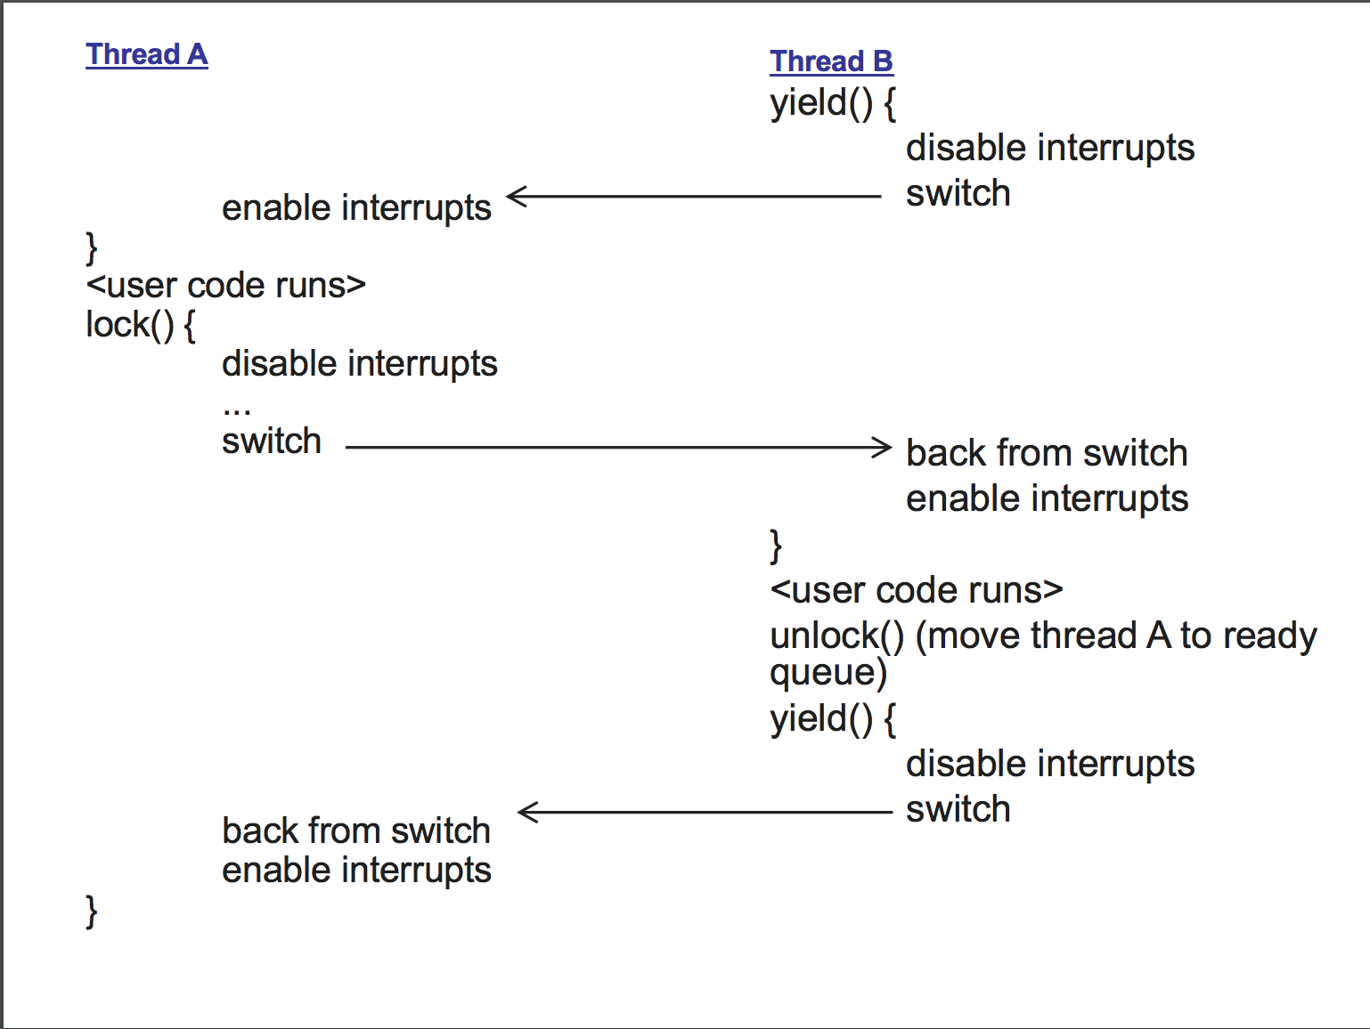

Slide 46
More Project 2 Misc

Slide 47
Thread lifetimes
Thread execution != thread object.
If thread object goes out of scope / gets deleted, thread execution still continues.
Is it safe to store a thread* in your ready queue / etc?
Who controls the lifetime of the thread object? User code or thread library code?

Slide 48
Recall from Lab 01
void func(void *a) {
auto my_num = reinterpret_cast<uintptr_t>(a);
cout << my_num << endl;
}
// Called from cpu::boot()
void main_thread(void *) {
// Spawn 4 threads and give each one a different num
for (int i = 0; i < 4; ++i) {
uintptr_t num = i * 42;
thread t(func, reinterpret_cast<void *>(num));
}
}
<-- func still runs (or maybe it finished already)
<-- t destroyed here

Slide 49
P2 misc: big design decisions
A few key points that your team will have to figure out:
How to separate lifetime of thread and thread object?
How to know when thread is finished?

Slide 50
Determining when a thread has finished running.
**uc_link will not be very useful for you in p2**
You can set uc_link to nullptr, unless you want to try using it.
You must figure out how to detect thread completion and deallocate resources at the proper time.

Slide 51
P2 tip: switching cpus in gdb
P2 infrastructure simulates cpus using real pthreads.
You can see and switch simulated cpus using:
(gdb) $ info threads
(gdb) $ thread <N>

Slide 52
P2 tip: printing output
**don't use cout in both the thread library and test cases**
You could deadlock on cout's internal mutex.
Thread library: use printf
User code: use cout

Slide 53
Testing Tips
Test cases you submit should not have interrupts enabled
How to test different interleavings of threads?
Use thread::yield!
Create test cases that test "0, 1, and many"
For example, write a test case that tests 0 threads on the join queue, 1 thread on the join queue, and many threads on the join queue
Testing just 1 thread on the join queue doesn't test the ordering that those threads will be run after the joined thread finishes

Slide 54
Project 2 Queues Illustration

Slide 55
CPU
thread1
Ready queue
mutexA (unlocked)

Slide 56
CPU
thread1
thread t2(...)
Ready queue
mutexA (unlocked)

Slide 57
CPU
thread1
thread t2(...)
Ready queue
mutexA (unlocked)
thread2

Slide 58
CPU
thread1
thread::yield()
Ready queue
mutexA (unlocked)
thread2

Slide 59
CPU
thread1
thread::yield()
Ready queue
mutexA (unlocked)
thread2

Slide 60
CPU
thread2
Ready queue
mutexA (unlocked)
thread1

Slide 61
CPU
thread2
mutexA.lock()
Ready queue
mutexA (unlocked)
thread1

Slide 62
CPU
thread2
mutexA.lock()
Ready queue
mutexA (locked)
thread1

Slide 63
CPU
thread2
thread::yield()
Ready queue
mutexA (locked)
thread1

Slide 64
CPU
thread2
thread::yield()
Ready queue
mutexA (locked)
thread1

Slide 65
CPU
thread1
Ready queue
mutexA (locked)
thread2

Slide 66
CPU
thread1
mutexA.lock()
Ready queue
mutexA (locked)
thread2

Slide 67
CPU
thread1
mutexA.lock()
Ready queue
mutexA (locked)
thread2

Slide 68
CPU
thread2
Ready queue
mutexA (locked)
thread1

Slide 69
CPU
thread2
mutexA.unlock()
Ready queue
mutexA (locked)
thread1

Slide 70
CPU
thread2
mutexA.unlock()
Ready queue
mutexA (locked)
thread1

Slide 71
CPU
thread2
Ready queue
mutexA (locked)
thread1

Slide 72
CPU
thread2
Why is the mutex still locked?
Ready queue
mutexA (locked)
thread1

Slide 73
CPU
thread2
thread::yield()
Ready queue
mutexA (locked)
thread1

Slide 74
CPU
thread2
thread::yield()
Ready queue
mutexA (locked)
thread1

Slide 75
CPU
thread1
thread1 can now continue running with the mutex
Ready queue
mutexA (locked)
thread2

Slide 76
Smart Pointers

Slide 77
Recall: Dynamic Memory
When we want to control the lifetime of an object, we can use dynamic memory
To use dynamic memory, we use raw pointers
new allocates memory for an object, and delete destroys the object and releases its memory:
class Player;
Player* p = new Player;
...
delete p;

Slide 78
Dynamic Memory - Ownership
For dynamically-allocated objects, ownership of an object means it is yours to keep or destroy as you see fit.
In C++, by ownership, we mean not just which code gets to refer to or use the object, but mostly what code is responsible for deleting it
When using raw pointers, we implement ownership in terms of where in the code we place the delete that destroys the object
This is error prone. What are some possible errors?
Notes:
Possible errors: Memory leaks, following pointers to memory that no longer exists

Slide 79
Smart Pointers
Just as RAII can help us manage the release of resources, is there something that can help us manage the deallocation of dynamic memory?
Smart pointers - class objects that behave like built-in pointers but also manage objects that you create with new so that you don't have to worry about when and whether to delete them
In C++, #include <memory> to use them

Slide 80
Smart Pointers
shared_ptr<T>
Implements shared ownership.
Any number of shared_ptrs can jointly own an object. When the last shared_ptr pointing to an object is destroyed, the object is automatically destroyed.
weak_ptr<T>
"Observes" a managed object, but does not own it or keep it alive.
Can obtain a shared_ptr from it with .lock()
Useful for tracking if an object is still alive.
unique_ptr<T>
Implements unique ownership.
Manages memory like a shared_ptr, but there can only be one unique_ptr to a given object at a time.
Can't be copied - requires move semantics.

Slide 81
Why smart pointers?
Ease of use: They handle deallocation for you, helping you avoid memory leaks and use-after-free bugs
Style grading: They can make your code more elegant, which can help you keep your codebase cleaner/simpler
Familiarity with the STL: They are widely used in C++ codebases and it is be useful to have experience with them
Avoiding Bugs: They can help you avoid bugs by enforcing certain invariants (e.g. unique ownership)

Slide 82
Extra Resources
Smart pointers take some time and effort to learn, but they can make your life much easier and your code much better!
For a more thorough introduction with examples, see the following resources:
https://github.com/eecs482/general-reference/blob/master/cpp/smart_ptrs/README.md
https://github.com/eecs482/general-reference/blob/master/cpp/move_semantics/README.md
http://websites.umich.edu/~eecs381/handouts/C++11_smart_ptrs.pdf

Slide 83
Questions?

Slide 84
CPUs in the Project 2 infrastructure
cpu::boot(4, func, arg, ...)
pthread
c = new cpu();
c->init();
pthread
c = new cpu();
c->init(
func, arg);
pthread
c = new cpu();
c->init();
pthread
c = new cpu();
c->init();
Notes:
The infrastructure simulates CPUs using real pthreads. So each CPU would be one thread in GDB, for example.
When you call CPU boot, it creates some number of simulated CPUs, constructs an instance of the cpu class for each one, and calls init() on each of the cpu instances from its respective pthread. (Only one cpu receives the func and arg as its init() parameters).

Slide 85
Project 2: Interrupts & Guard

Slide 86
Two levels of synchronization
Within one cpu:
interrupt_disable()
interrupt_enable()
Nobody on this cpu can interrupt me until I'm done.
Between multiple cpus:
lock guard
release guard
Nobody on any other cpu can do their critical section until I'm done.

Slide 87
How to use the guard in P2
// In cpu.h
extern std::atomic<bool> guard;
void some_kernel_function(...) {
while (guard.exchange(true)) {}
/* critical code */
guard.set(false);
}

Slide 88
Switch invariant
All threads must have interrupts disabled and hold the guard during a context switch.
All threads assume that interrupts are disabled and the guard is held upon returning from swapcontext

Slide 89
Switch invariant
// what needs to happen here?
swapcontext(current, next);

Slide 90
Switch invariant
cpu::assert_interrupts_enabled();
cpu::interrupt_disable();
while (guard.exchange(true)) {}
swapcontext(current, next);
// what can we assume upon returning?

Slide 91
Switch invariant
cpu::assert_interrupts_enabled();
cpu::interrupt_disable();
while (guard.exchange(true)) {}
swapcontext(current, next);
cpu::assert_interrupts_disabled();
assert(guard);

